Slide 1
Linear Regression

Slide 2
What is Linear Regression?

Slide 3
First we need to understand what ‘Regression’ is.
Notes:
1. You MUST know the definition of ‘Regression’. This is a very popular knowledge question asked during an interview.

Slide 4
Regression = How One Variable Depends on Another
Example : What is the relationship between ‘Height’ and ‘Weight’ of Men?
Usually, the taller the man, the heavier he is.
Example : What is the relationship between ‘Smoking in Years’ and ‘Cancer Likelihood’?
Usually, the longer the person smokes, the greater probability of being infected with cancer.
Notes:
1. For more information on ‘Regression,’ make sure to take a look at the pptx titled ‘Regression.’ This is a statistical study you definitely want to master.

Slide 5
So what does ‘Regression’ have to do with ‘Linear Regression’?
The regression line for an output variable ‘y’ for a given feature ‘x’ estimates the average value for ‘y’ corresponding to each value of ‘x.’
In other words, linear regression attempts to predict ‘y’ given an input ‘x.’

Slide 6

Anatomy of Linear Regression
$$h_{θ}\left(x\right)= θ_{0}x_{0}+ θ_{1}x_{1}$$

Slide 7
Anatomy of Linear Regression
$$h_{θ}\left(x\right)= θ_{0}x_{0}+ θ_{1}x_{1}$$
This is equal to 1

Slide 8
QUESTION : Convert this function to only vectors ONLY
$$h_{θ}\left(x\right)= θ_{0}x_{0}+ θ_{1}x_{1}$$

Slide 9
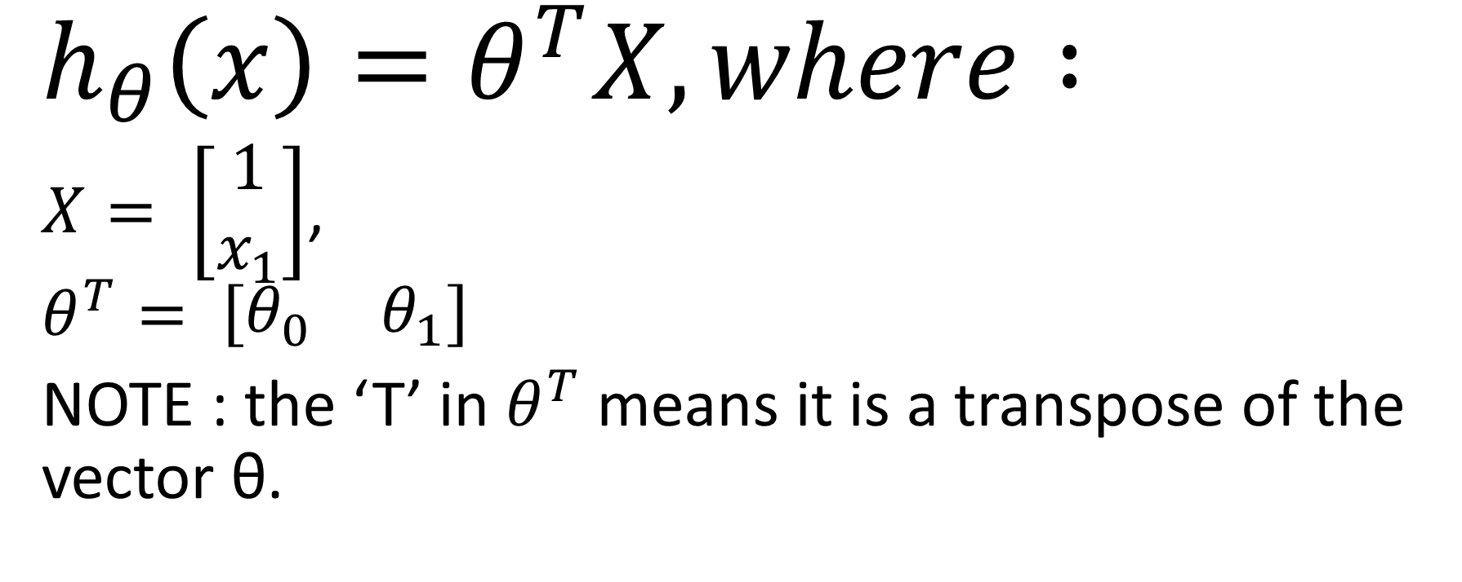
ANSWER :
$$h_{θ}\left(x\right)=θ^{T}X, where :$$
$X= \left[\begin{matrix}1 \\ x_{1}\end{matrix}\right]$,
$$θ^{T}= \left[\begin{matrix}θ_{0} & θ_{1}\end{matrix}\right]$$
NOTE : the ‘T’ in $θ^{T}$ means it is a transpose of the vector θ.

